Slide 1
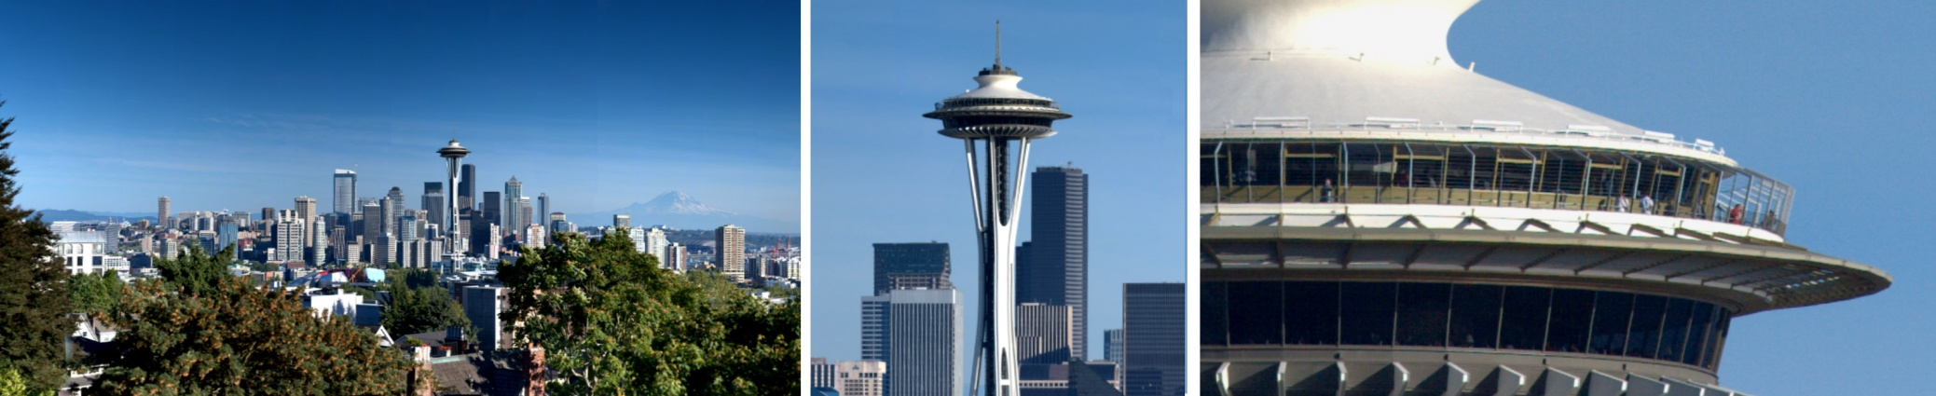
High Definition Image Capture and Viewing with Gigapixel
Presented By
Okeke Stephen
By
Johannes Kopf ^{1,2}
Matt Uyttendaele ¹
Oliver Deussen ²
Michael Cohen ¹
Supervisor
Prof Lee Byung Gook

Slide 2
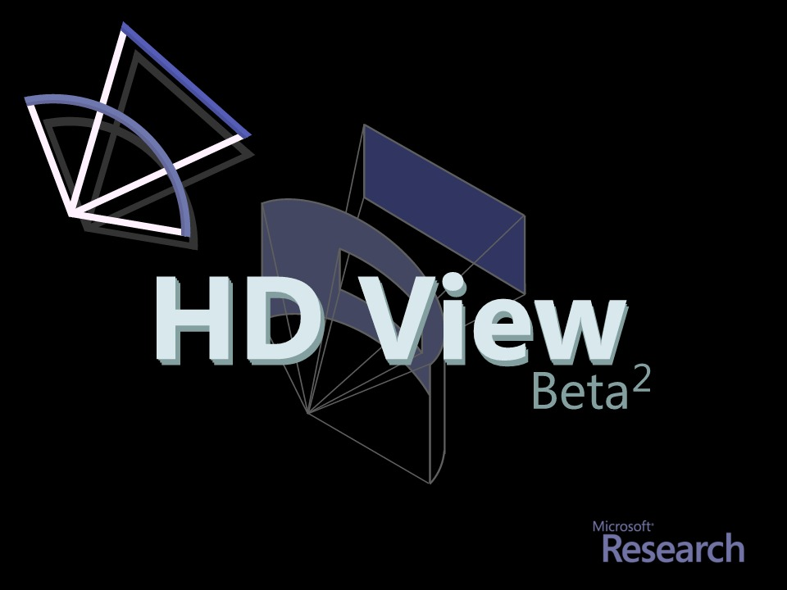

Slide 3

Browser is a Camera
Gigapixel Image == Slice of Lightfield
Rays through Point
Dense
Billions of Rays
Gigapixels

Slide 4
Browser is a Camera
Gigapixel Image == Slice of Lightfield
Rays through Point
Dense
HDR

Slide 5
Browser is a Camera
Gigapixel Image == Slice of Lightfield
Viewer == Camera
Point It

Slide 6
Browser is a Camera
Gigapixel Image == Slice of Lightfield
Viewer == Camera
Point It
Zoom in

Slide 7
Browser is a Camera
Gigapixel Image == Slice of Lightfield
Viewer == Camera
Point It
Zoom out

Slide 8
Browser is a Camera
Gigapixel Image == Slice of Lightfield
Viewer == Camera
Point It
Zoom in/out
Warp Film

Slide 9
Browser is a Camera
Gigapixel Image == Slice of Lightfield
Viewer == Camera
Point It
Zoom in/out
Warp Film
Change
Exposure

Slide 10

Browser is a Camera
Gigapixel Image == Slice of Lightfield
Dense sampling in direction (i.e., high res)
Deep bit depth in radiance (i.e., HDR)
Single point in space and time (i.e., an image)
Viewer == Camera
point it (i.e., panning)
zoom (i.e., change the focal length of your lens)
change exposure
can’t move it, focus it (yet)

Slide 11
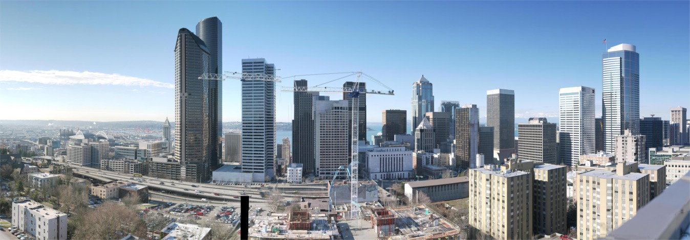
BIG
3,600,000,000 Pixels
Created from about 800 8 MegaPixel Images

Slide 12
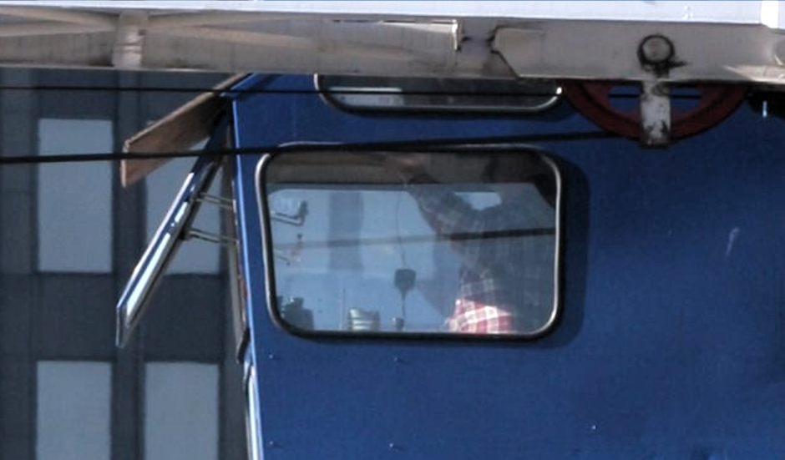
BIG

Slide 13
Wide
150 degrees
“Normal” perspective projections cause distortions.

Slide 14
Deep
100X variation in Radiance
High Dynamic Range

Slide 15
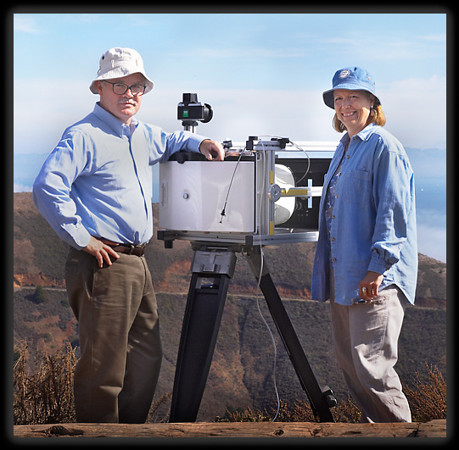
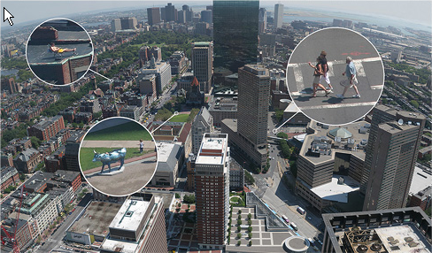
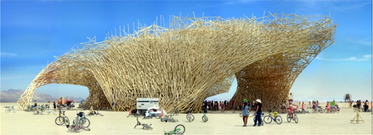
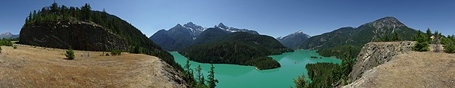
Related Work
Lots!
Panoramic Stitching, High Dynamic Range and Tone Mapping, Perspective and Curved Projections, etc.
Gigapixel Image Capture
Graham Flint (Gigapixl)
Gigapan (@cmu)
Max Lyons
Haltadefinizione
XRez
Bradford Bohonus
Viewing
Quicktime VR
Zoomify
Flash Based
Graham Flint
XRez
Gigapan
Bohonus

Slide 16
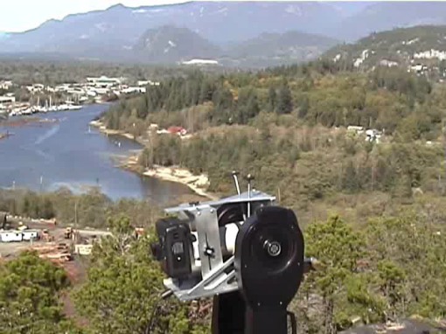
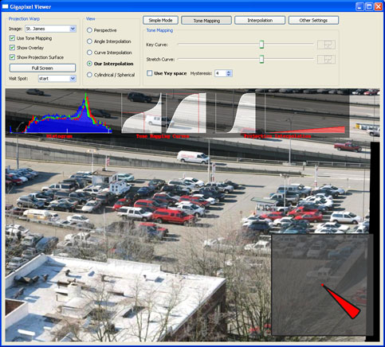

Capturing and Viewing Gigapixel Images
Capture: Matt Uyttendaele
Viewer: Johannes Kopf
HD View: Matt Uyttendaele

Slide 17
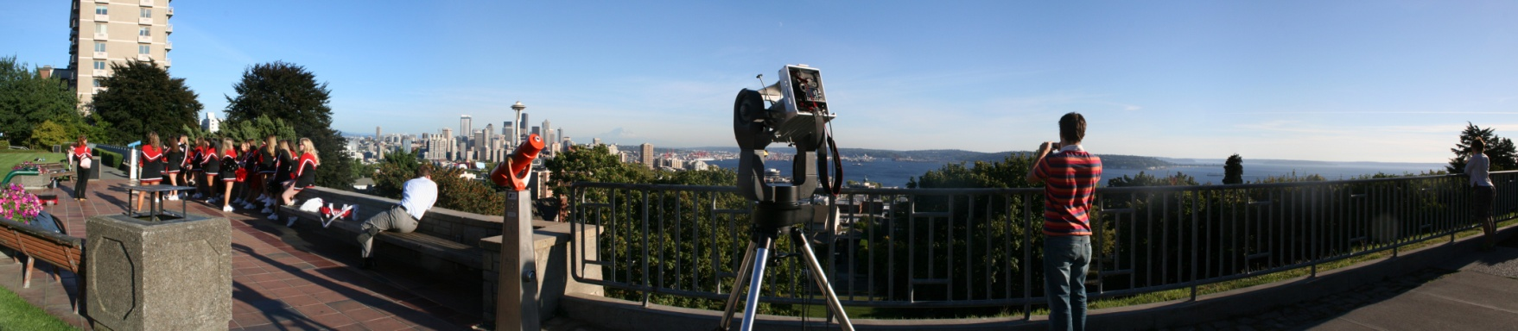
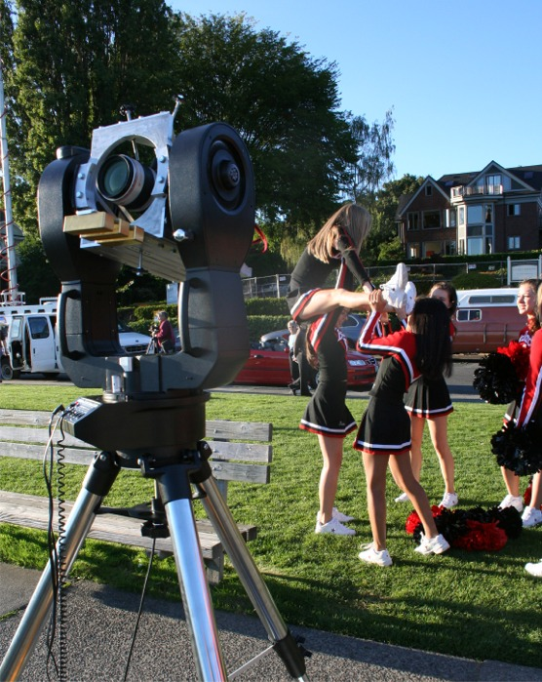

Capture

Slide 18
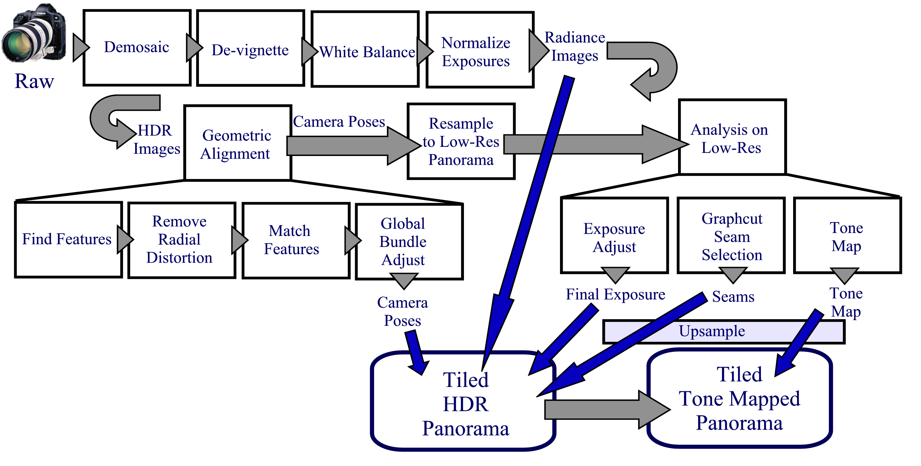
Capturing Gigapixel Images

Slide 19
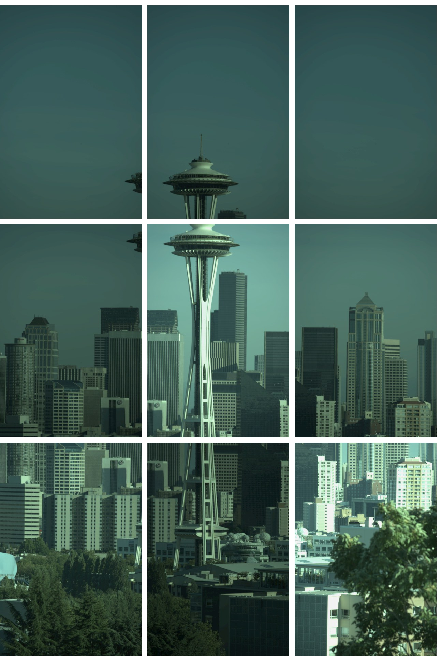
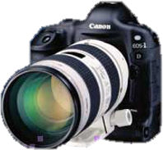
RAW

Slide 20
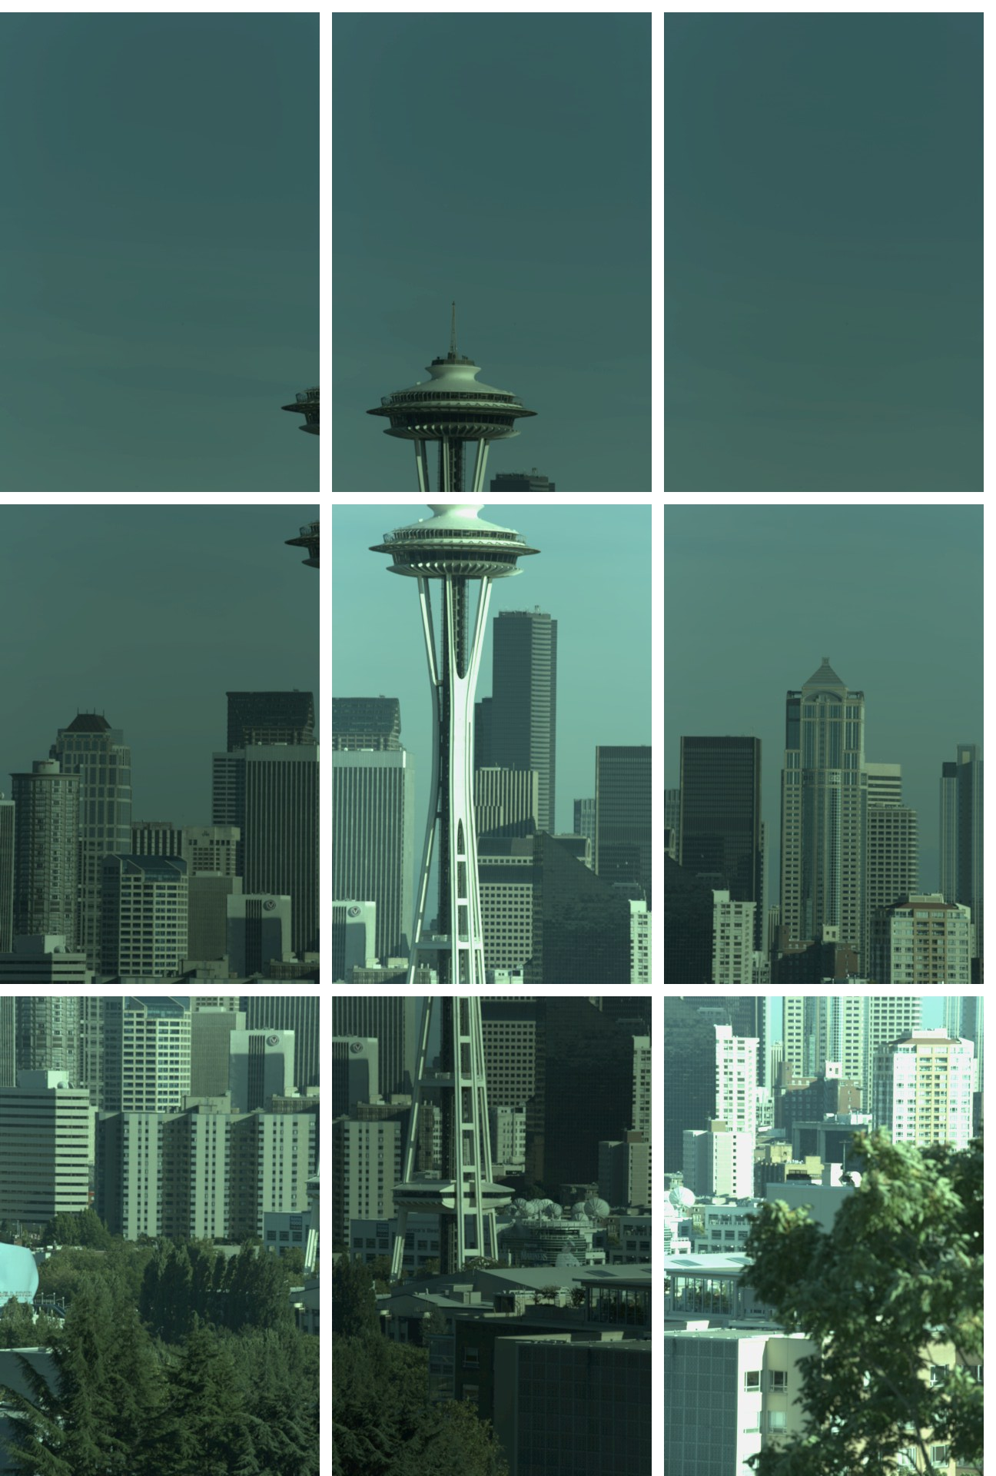
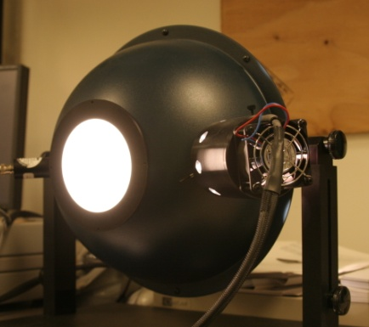
DeVignette

Slide 21
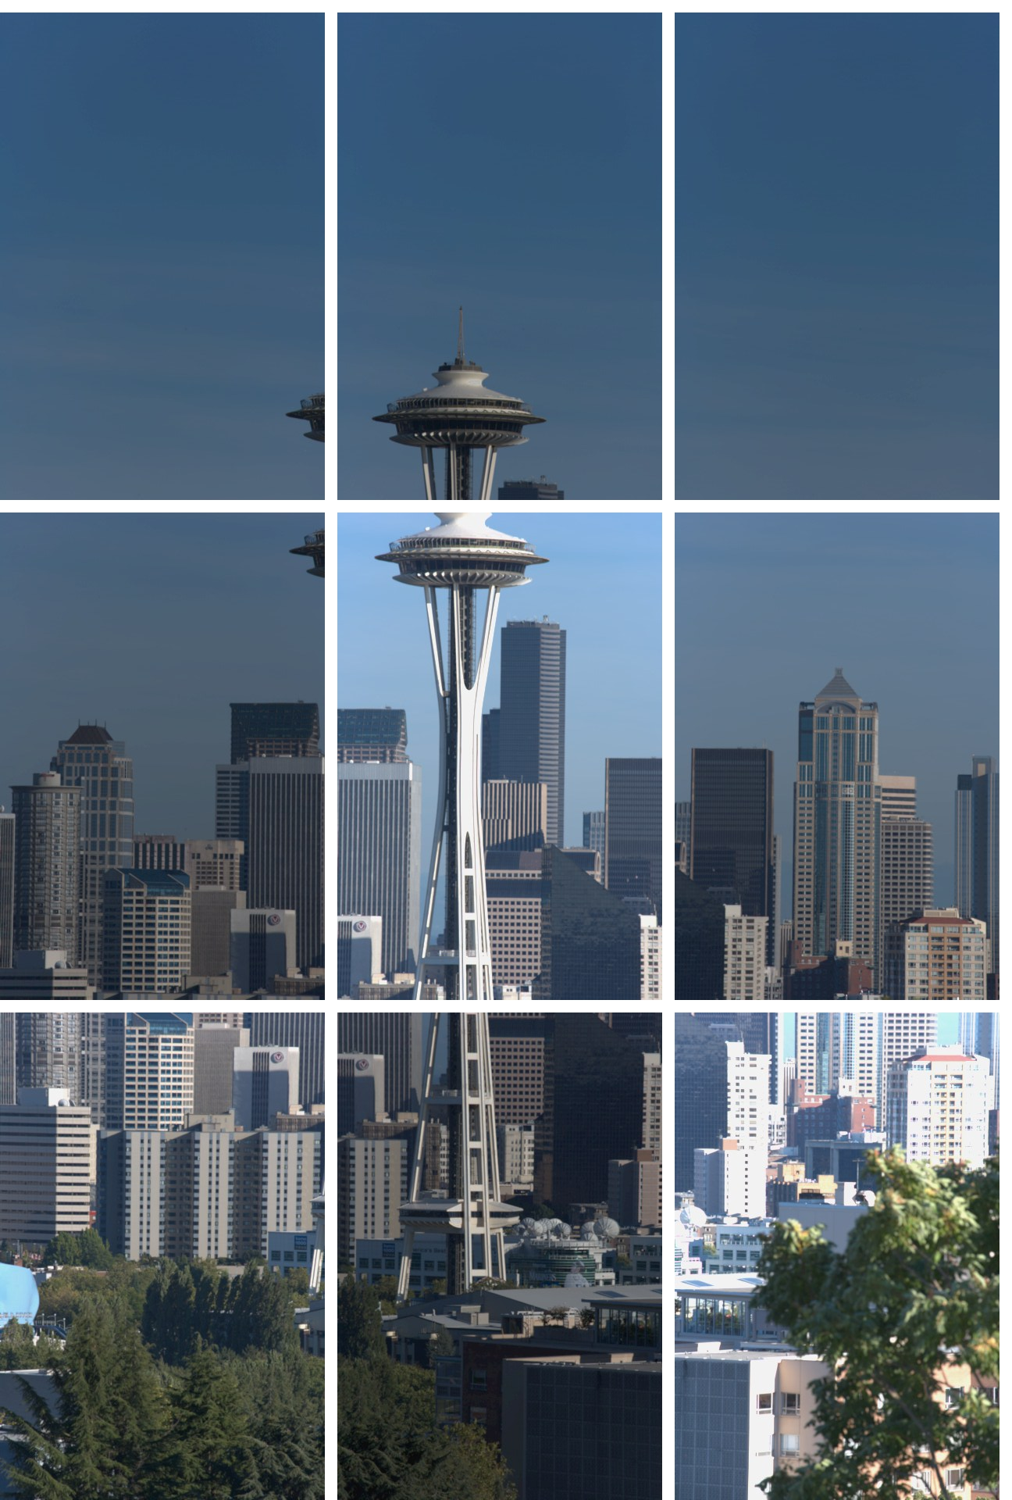
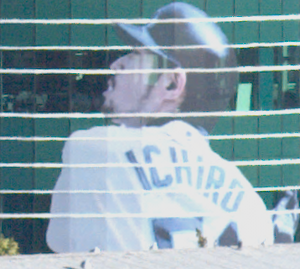
White
Balance

Slide 22
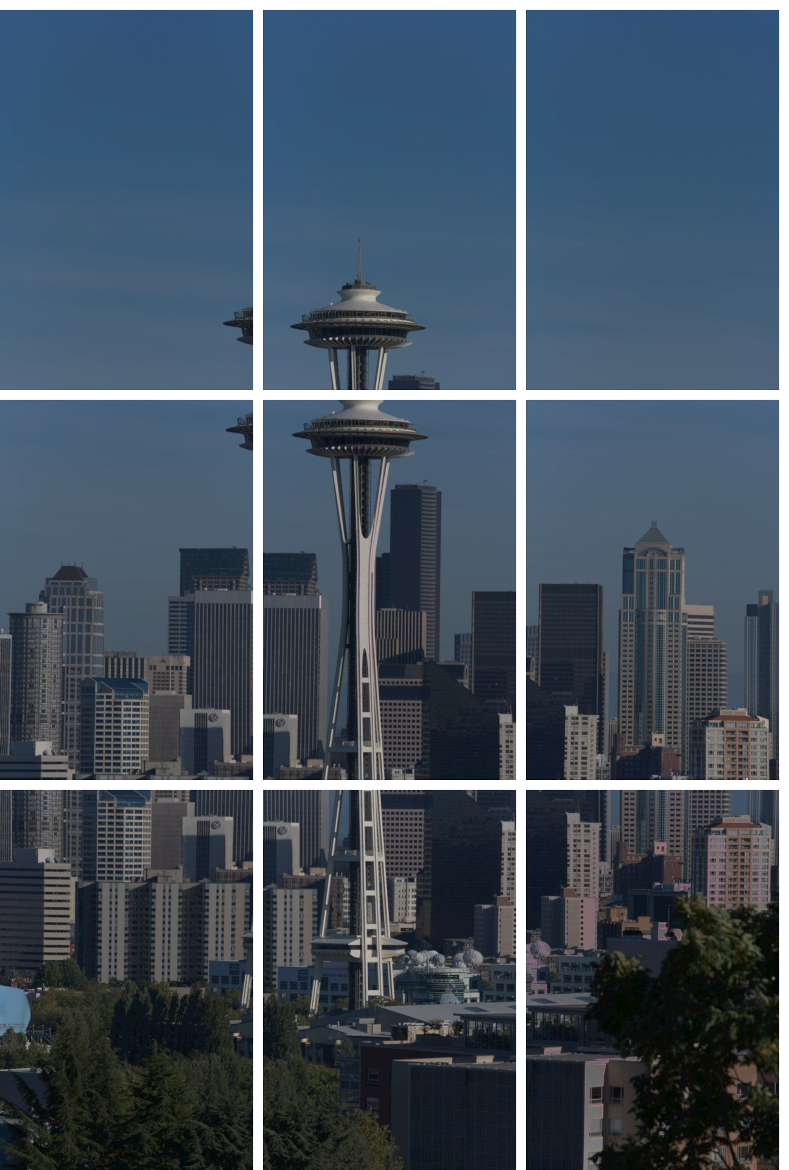
Exposure
Balance
Radiance
Map

Slide 23

Feature
Points

Slide 24
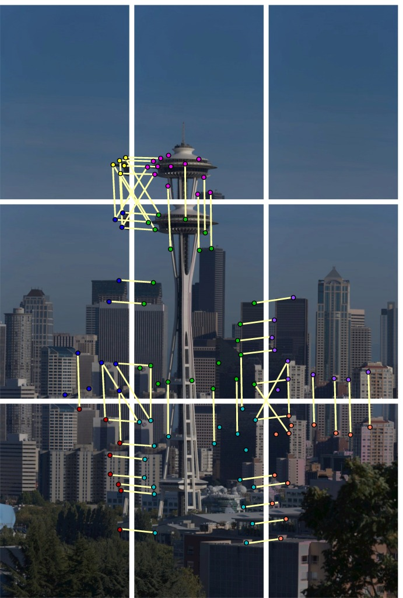
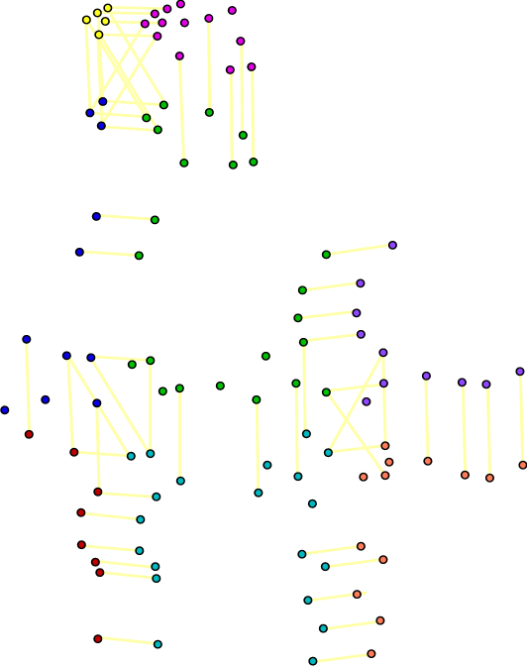
Feature
Matches

Slide 25
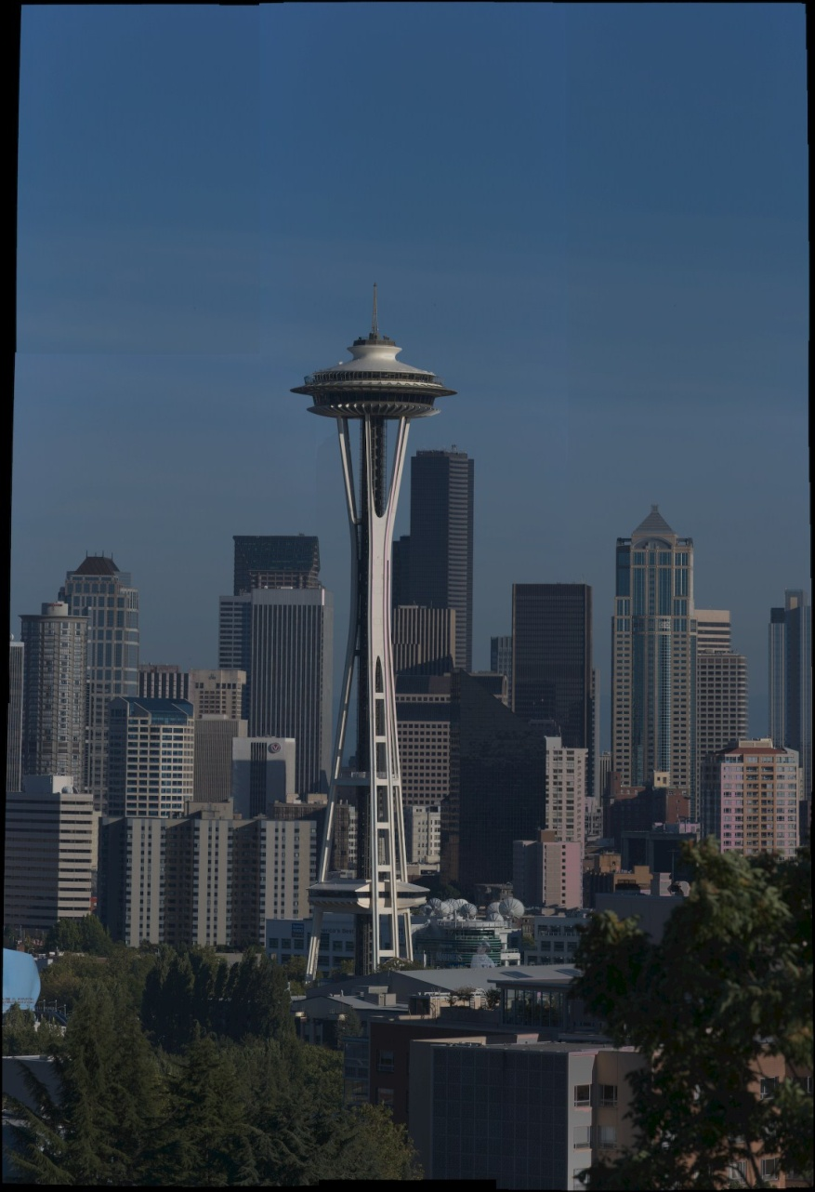
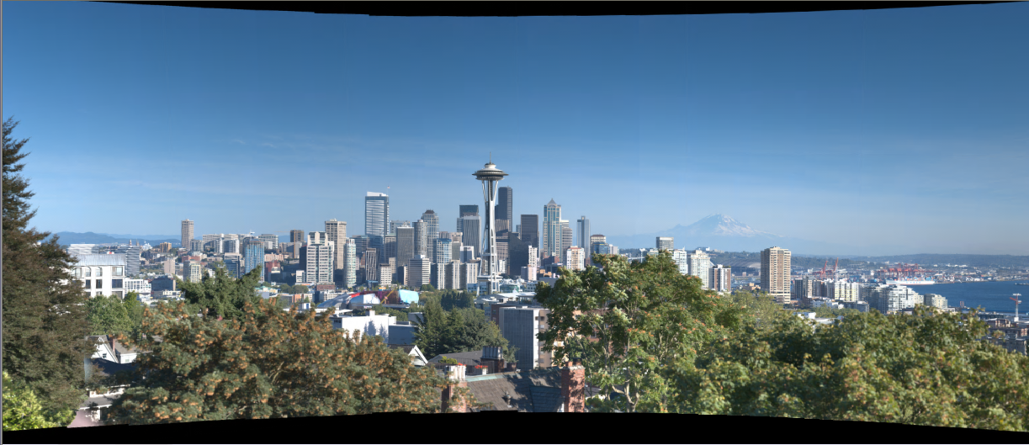
Align
Aligned
Tone Mapped

Slide 26
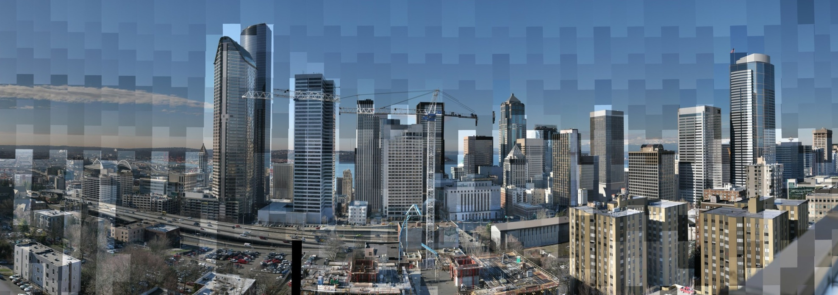
Radiometric Alignment
1 / 1000th
of a second
1 / 10th
of a second
High Dynamic Range

Slide 27
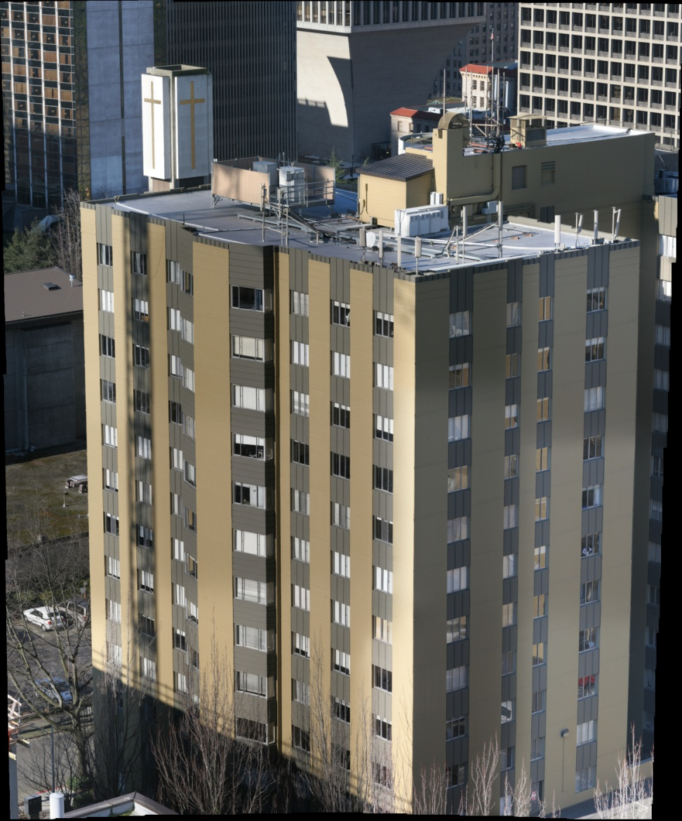
Radiometric Alignment
Laplacian Blend

Slide 28
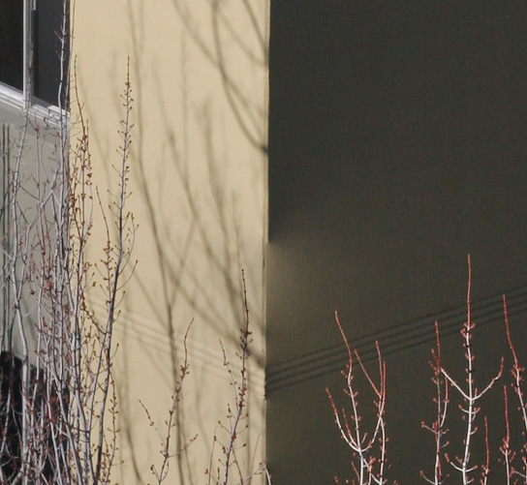
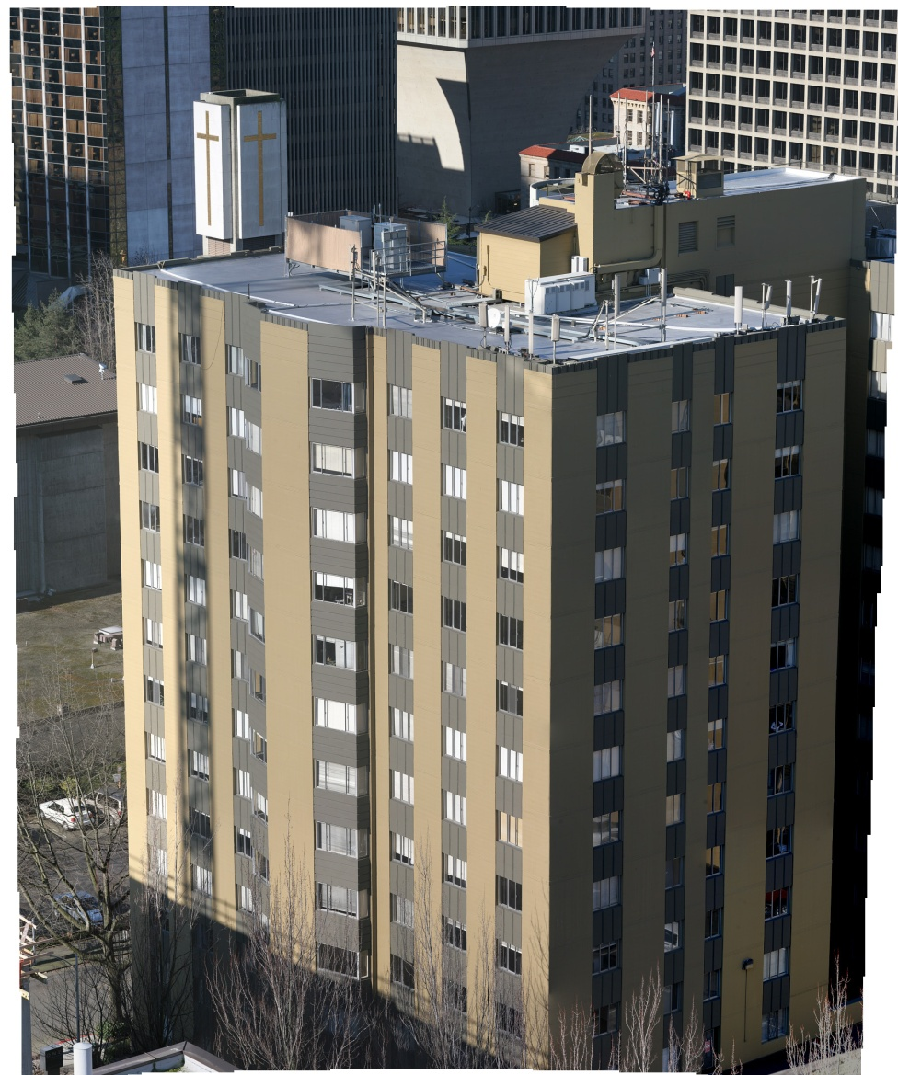
Radiometric Alignment
Poisson Blend

Slide 29
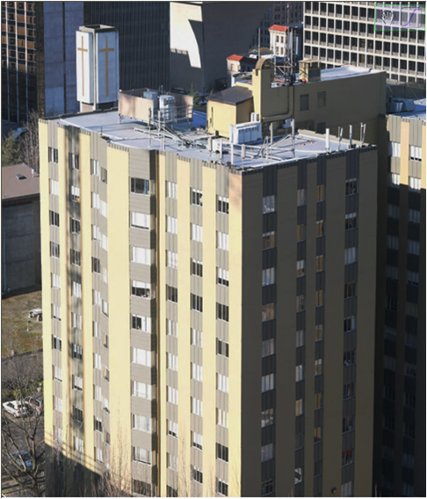
Radiometric Alignment
Pure Radiometric

Slide 30
Radiometric Alignment
High Dynamic Range

Slide 31
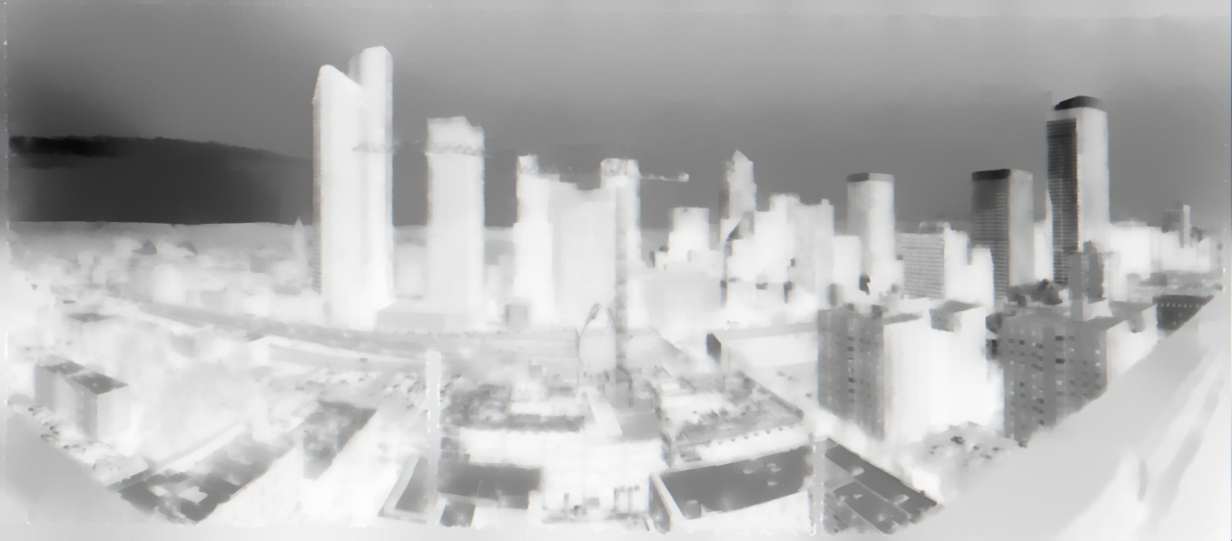
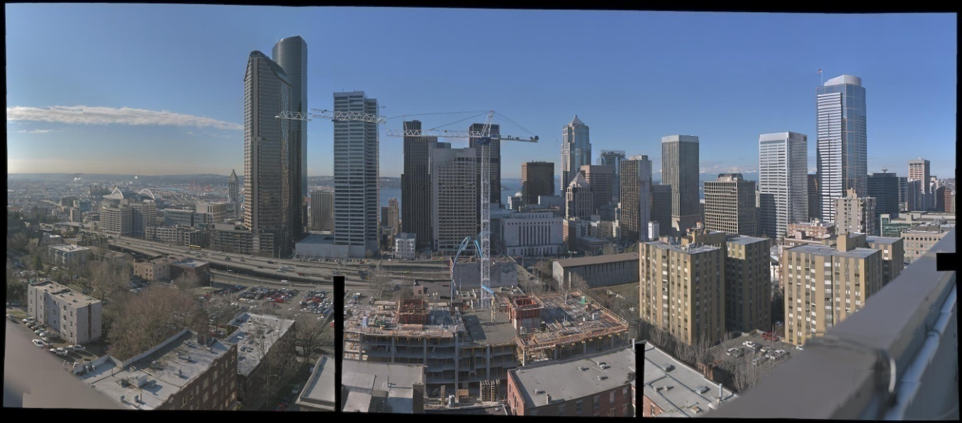
Solution Upsampling
2815 x 1238
90080 x 39616

Slide 32
Capturing Gigapixel Images

Slide 33
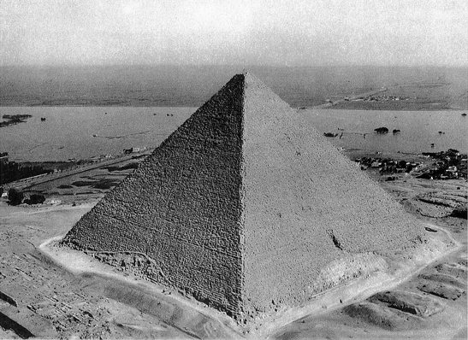
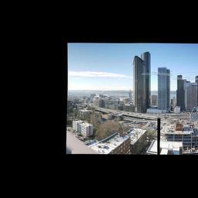
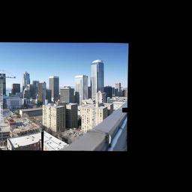
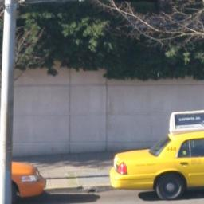
Tile Pyramid

Slide 34


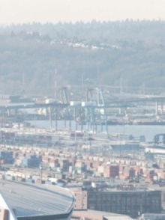
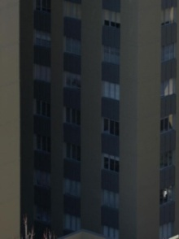

Viewer
Resolution >> Display
Dynamic Range >> Display
Field of view >> Display
150 degrees
Notes:
If we want to view the images on a computer screen, we really need a special viewer for a number of reasons that Michael mentioned in the beginning of the talk
The resolution of the images is much higher than the screen
Also, the dynamic range has double the bit depth
Finally, the FOV of the images is usually much wider than the FOV that your monitor subtends when you sit in front of it.
As I will show, all these issues can be alleviated with an interactive viewer

Slide 35

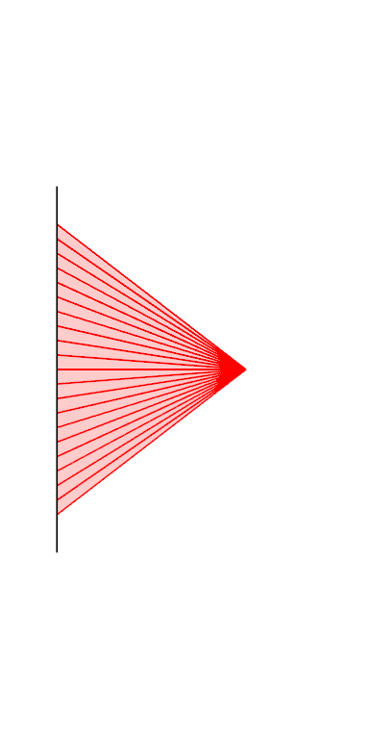
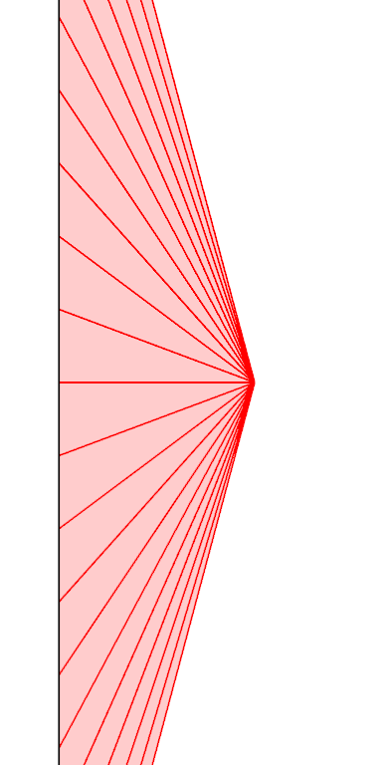
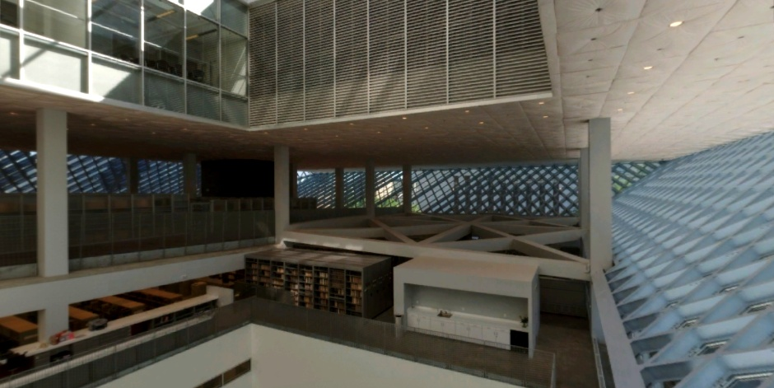
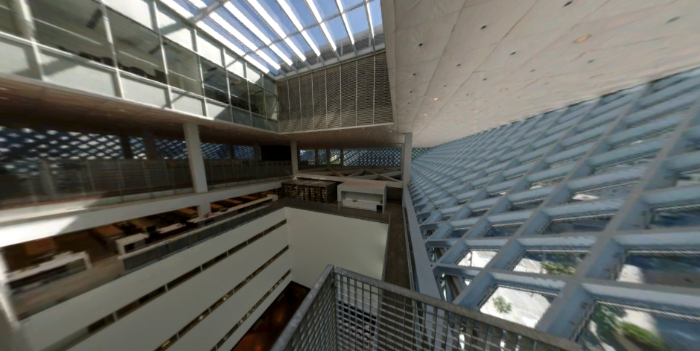
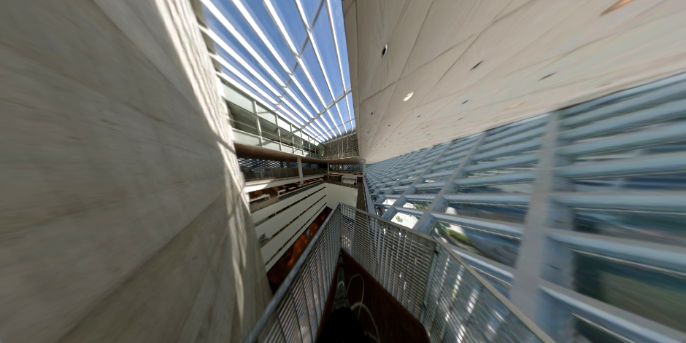
Perspective Projection

Slide 36
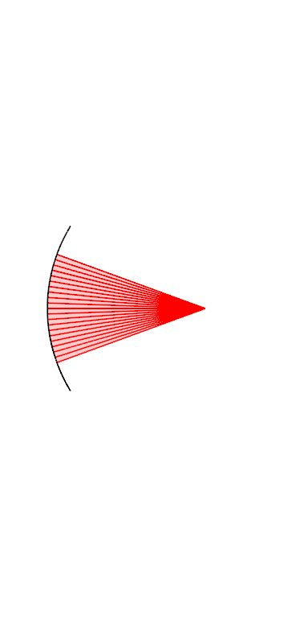
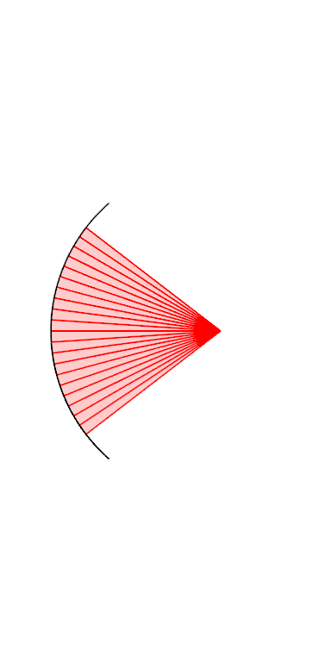
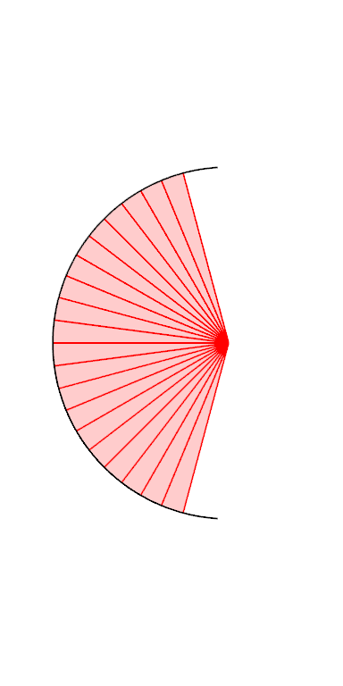
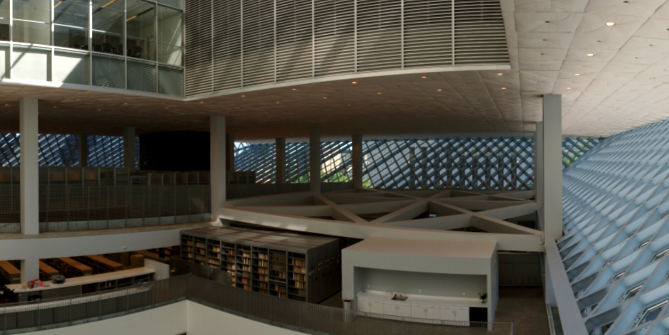
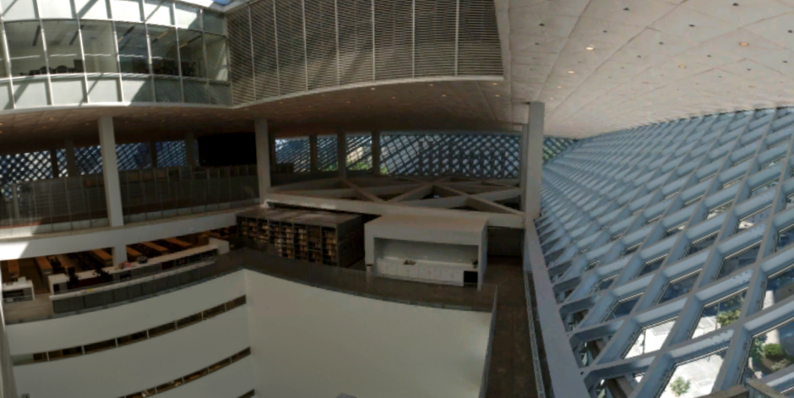
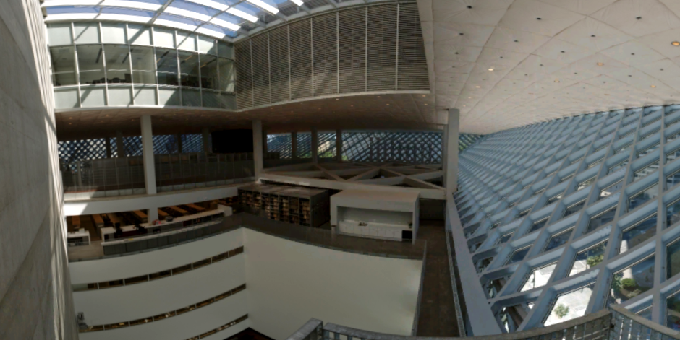
Cylindrical Projection

Slide 37
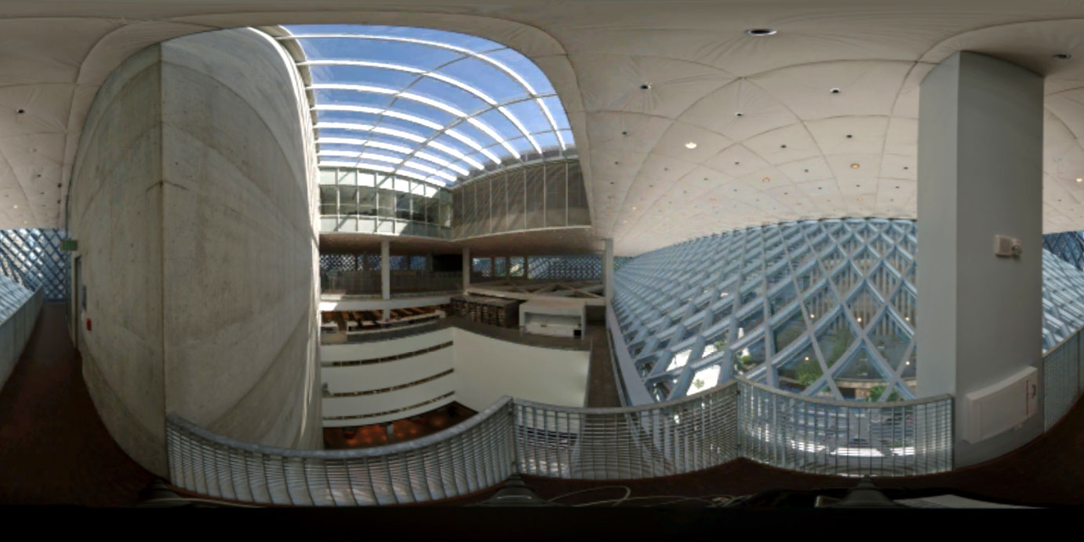
Spherical Projection

Slide 38

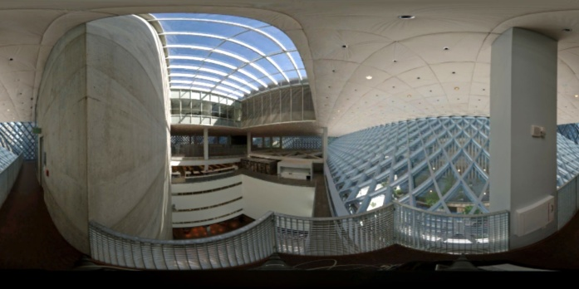
Perspective vs. Cylindrical/Spherical
Perspective | Cylindrical / Spherical
Close to human perception | Straight lines → curved
Straight lines → straight | Feels flat
Wide angle distorted | Whole FOV possible
= Best for narrow angles | = Best for wide angles

Slide 39
Dynamic Tone Mapping

Slide 40




Dynamic Tone Mapping
Start Demo

Slide 41






Browser plugin –
Internet Explorer or Firefox on Windows
Features
GPU acceleration
Dynamic FOV adjustment
Dynamic Tone adjustment
HD Photo (soon to be JPEG XR)
Content
Lots of content already on the web
Easy to create your own

Slide 42
Future Work
Better scene sampling
More pixels interesting areas, less in blank areas e.g. sky
Depth of field control
HDR
Deal with atmospheric effects
Capture moving objects
Viewing
Color temperature
Better dynamic scene analysis
Combine with Photosynth
High Dynamic Range Streaming
Editing/Annotating Gigapixel Images

Slide 43


Summary
Capturing Gigapixel Images
Stitching panorama into a radiance map.
A novel viewer
Dynamically adapts to field of view
Dynamically adapts tonal adjustment
New web content to browse
Thank You

